Slide 1


KRAKEN QGIS PLUGIN • USER MANUAL
GCell Generator
High-performance spatial sector geometry engine for large-scale RAN optimization and network visualization in QGIS.
600k+
Multi-Engine
Auto-Styling
Rows Processed in Seconds
PyArrow, Calamine & GDAL C++
GPKG & Dynamic QML Export
Kraken © 2026 | akanipatra@gmail.com

Slide 2

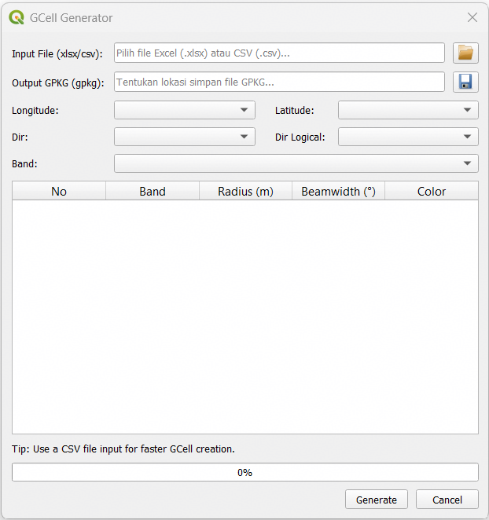
WORKFLOW PHASE 01
Data Ingestion & Field Mapping
01
Select Source File
Load cellular dump data via .csv or .xlsx. Accelerated by PyArrow C-Engine and Rust Calamine parser.
02
Set Coordinates & Azimuth
Map Longitude, Latitude, and orientation columns (Dir & Logical Dir with automatic fallback logic).
03
Designate Layer Band
Select the Band column to trigger automatic distinct value scanning for multi-layer sector customization.
Kraken © 2026 | akanipatra@gmail.com

Slide 3
WORKFLOW PHASE 02
Sector Geometry & Symbology Tuning
Coverage Radius
Beamwidth
Layer Palette
Specify radius in meters per frequency band to visualize cell coverage boundaries effectively.
Set horizontal aperture width in degrees. Macro cells generate pie wedges; PICO sites form full circles.
Customize hex fill colors for each band using integrated QGIS color buttons with HSV auto-distribution.
Automated Plot Ordering
Bands are automatically assigned rendering priority to prevent smaller frequency sectors from being hidden under larger ones.
Auto-Z Index
Kraken © 2026 | akanipatra@gmail.com

Slide 4

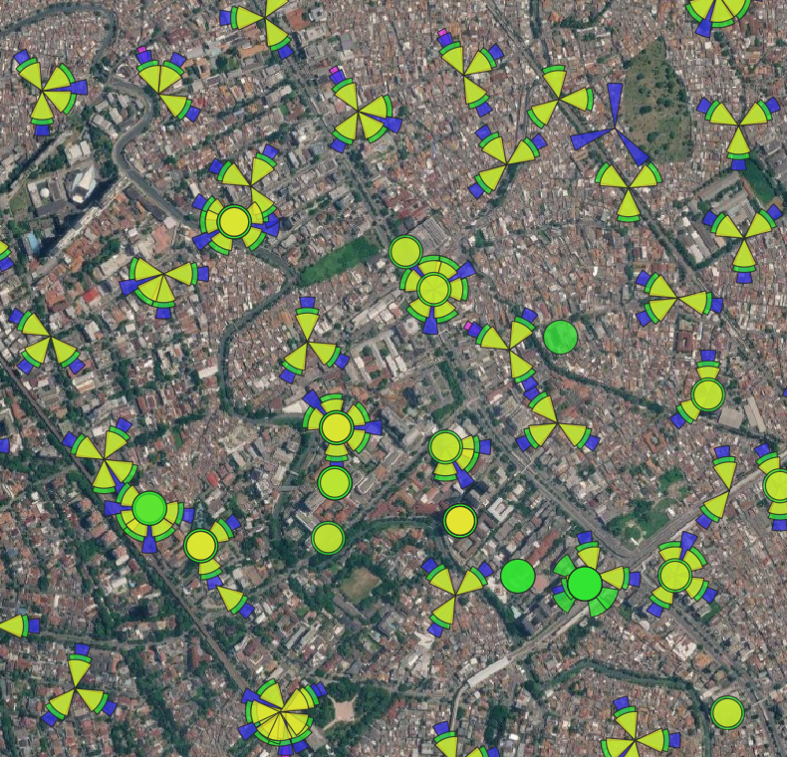
WORKFLOW PHASE 03
Generation & Spatial Output
GeoPackage Export (.gpkg)
Spatial Vector
Outputs high-performance spatial databases with native C++ bulk transactions and auto-generated spatial indexes.
Style File Generator (.qml)
Categorized Symbology
Creates paired QML style files matching configured band colors, opacity settings, and rendering order rules.
Automatic Canvas Load
QGIS Integration
Instantly imports structured vector layers into the active QGIS project canvas upon completion.
Kraken © 2026 | akanipatra@gmail.com

Slide 5

SUMMARY & PERFORMANCE TIPS
Optimization Best Practices
Use CSV Input
Direction Fallback
PICO Cell Handling
For massive dumps exceeding 500k rows, convert .xlsx to .csv to leverage multi-threaded PyArrow processing.
Logical Dir is prioritized over physical Dir. Missing azimuths automatically default to 0.0° North orientation.
Omni-directional PICO sites automatically render as centered circular geometries and take top rendering priority.
Kraken QGIS RAN Optimization Plugin • GCell Module Engine 3.0
Kraken © 2026 | akanipatra@gmail.com

